Slide 1
课程报告
MF1833061 沈思远

Slide 2
Introduction
A running example
Introduction to refactoring tools
Implementation challenges

Slide 3
Introduction
The major part of the total software development cost is devoted to software maintenance
Refactoring can improve the internal software quality
the transformation from one representation form to another at the same relative abstraction level, while preserving the subject system’s external behavior
Improve software system’s internal structure

Slide 4
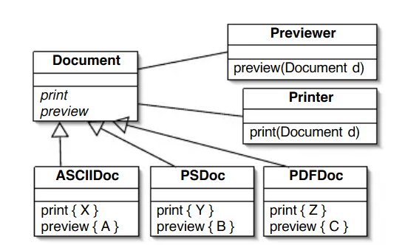
A running example
This design is not optimal

Slide 5
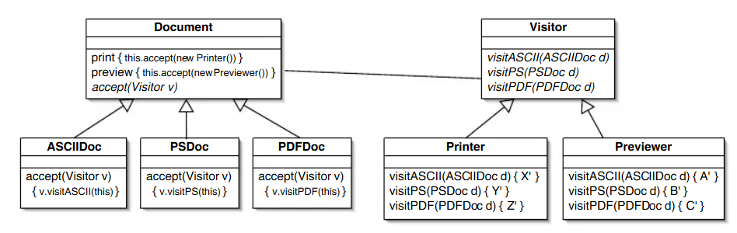
A running example
new functionality can be added by simply creating a new subclass of Visitor , and implementing the visit* methods appropriately.

Slide 6
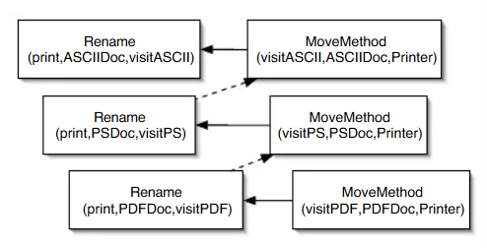
Composite refactoring for renaming and moving print methods from the Document subclasses to the Printer class

Slide 7
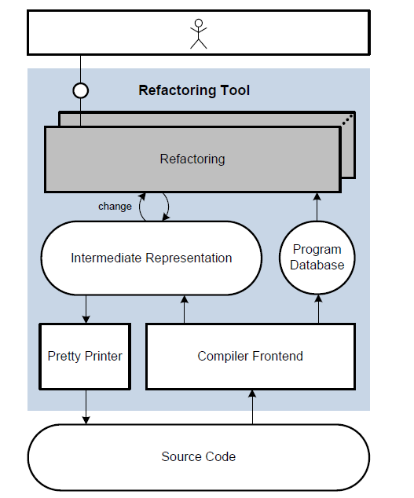
Introduction to refactoring tools
Fundamental architecture

Slide 8
Implementation Challenges
implementers of refactoring tools have to deal with two types of problems
Fundamentally hard problems are common to all refactorings
Incidental problems are highly language and refactoring specific

Slide 9
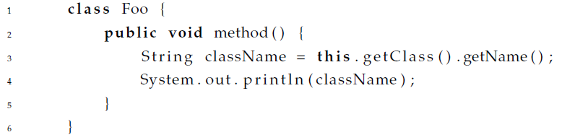
Behavior Preservation
Refactorings must preserve external behavior by definition. Unfortunately behavior itself is not defined.
Opdyke’s description : same inputs result in same outputs
Not enough
Rename Foo to Bar

Slide 10
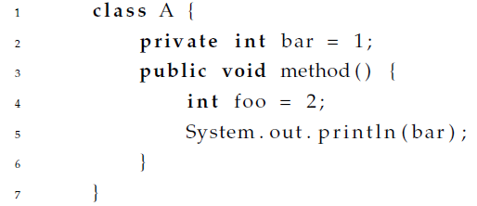
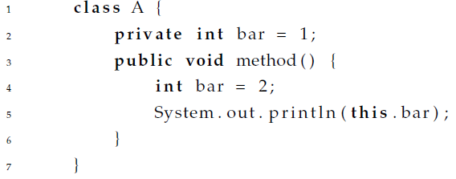
Behavior Preservation
Require the preservation of the syntactic and semantic properties of a program
Detecting the potential name shadowing
Pointer is more difficult

Slide 11
Behavior Preservation
Real-time systems and embedded systems
resource and runtime constraints
memory usage and power consumption

